Slide 1


File Transfer Guide
(U: Drive & OneDrive)
Table of Contents
Goals/Mission Statement
OneDrive and U: Drive Explained
Setting Up the OneDrive
Backing Up All Your Files to the OneDrive
Saving Files to Your U: Drive

Slide 2

CCE Goals/Mission Statement
In today's digital workplace, keeping your important work files safe is crucial. This guide will help you find a secure place for your files, making sure they don't get accidentally deleted or lost due to technical issues. By following these simple steps, you can safeguard your work-related information and maintain a reliable and secure work environment. Let's get started on ensuring the safety of your valuable work files.

Slide 3

OneDrive and U: Drive Explained
We will be using these two tools to ensure the safety and protection of our files. By using them, we can confidently store and access our files with the assurance that they are well-protected and backed up.
OneDrive - Microsoft's cloud storage service that enables users to store, access, and share files securely across devices with internet connectivity, with up to 1 Terabyte of storage.
U: Drive – As the name implies, this is a drive for U to store your files, with up to 10 Gigabytes of storage.
:
U: for U

Slide 4
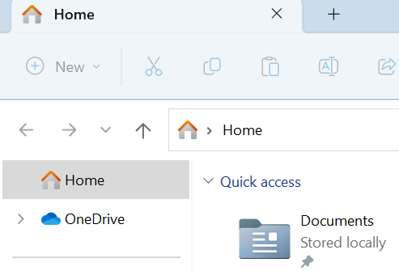
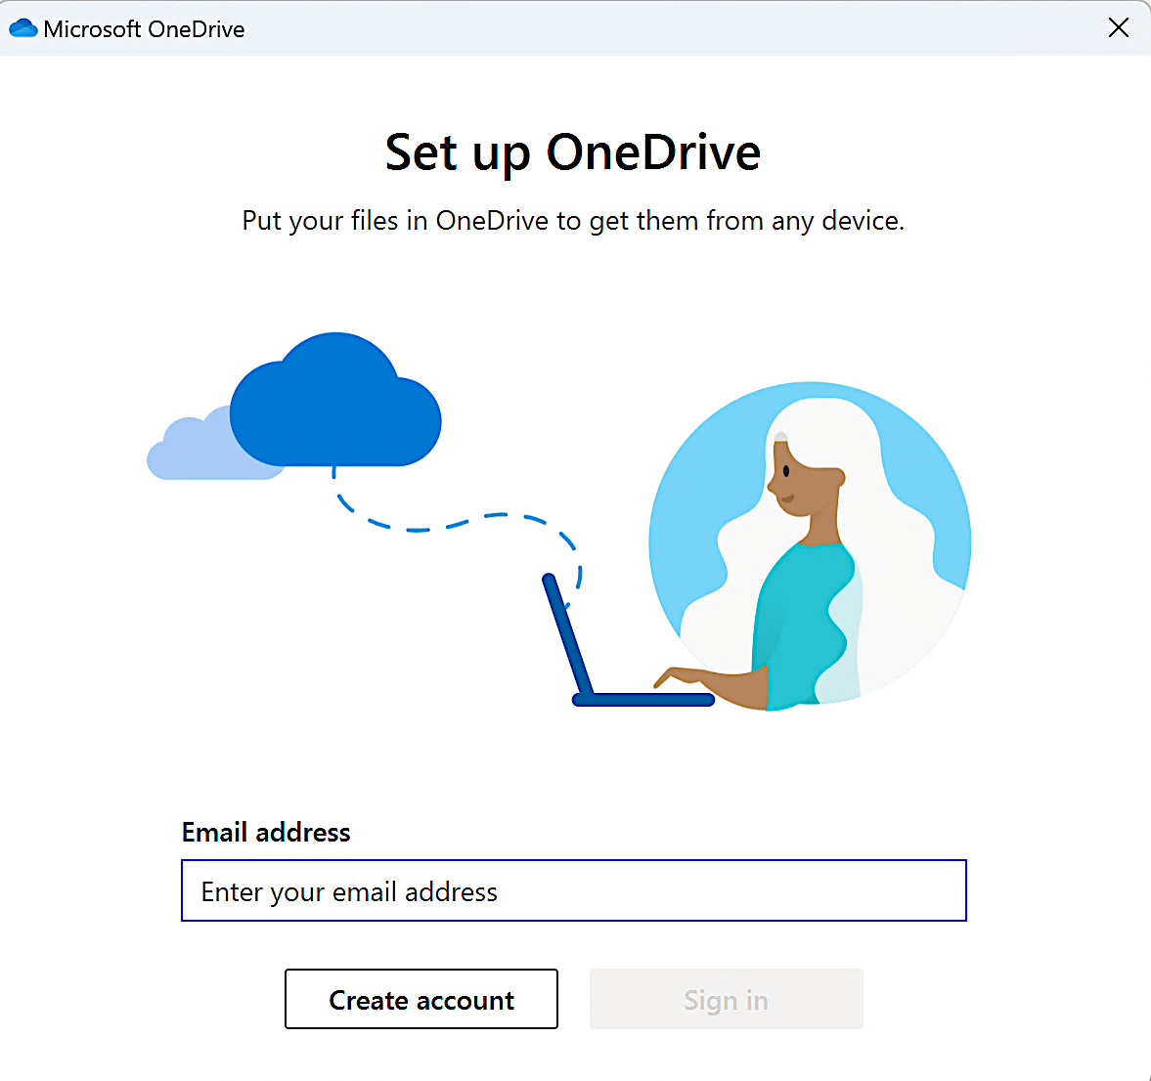
Setting Up the OneDrive
Navigate to your File Explorer and click on the OneDrive icon.
You will be prompted to…
Enter your work email address and click Sign in. or Create Account?

Slide 5
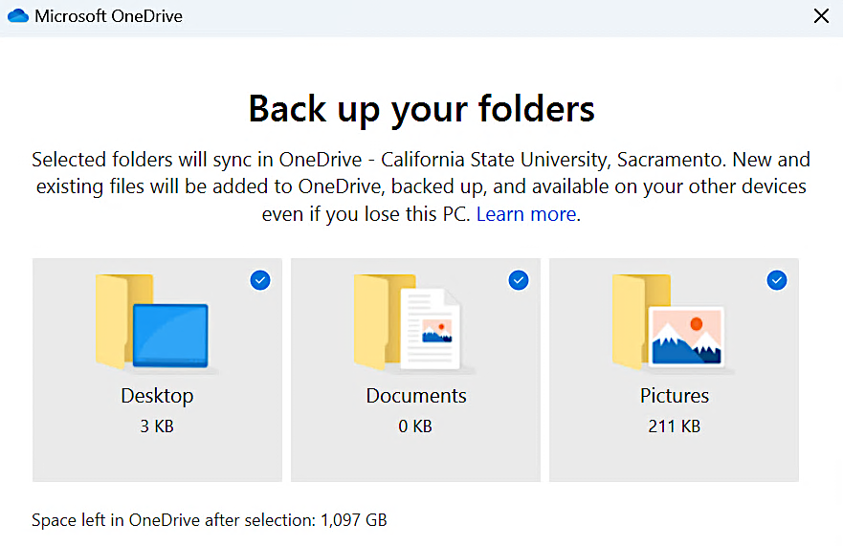
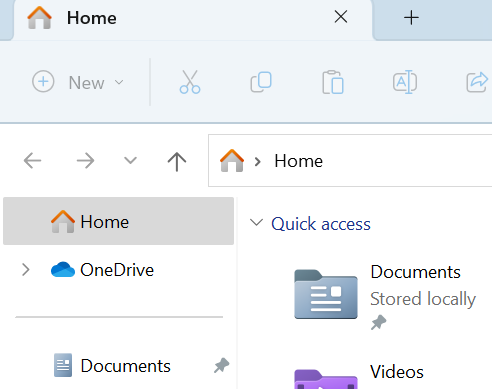
Setting Up OneDrive
You will be prompted to…
Make sure all options are selected.
Continue with set up. At the end, you will be asked to download the app, which is completely optional.
Congratulations! Your OneDrive is set up and ready to go.
6. You can access your files by clicking on the One Drive icon.

Slide 6
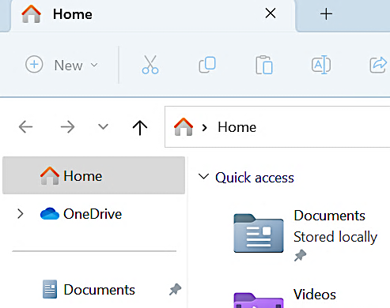
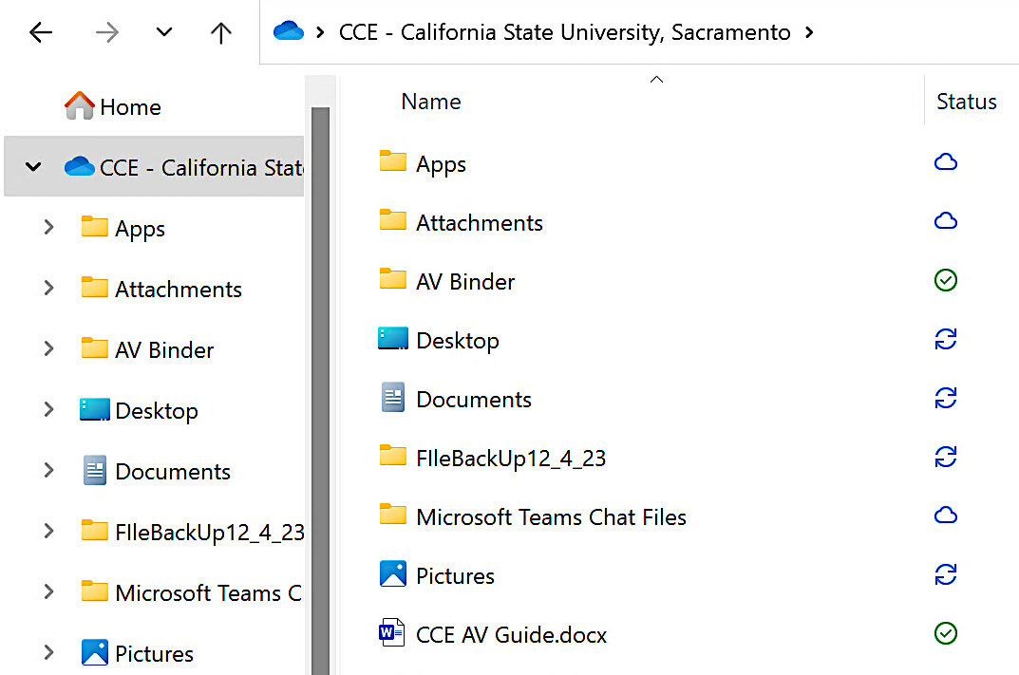
Backing Up All Your Files to OneDrive
Navigate to File Explorer and click on the OneDrive icon.
Create a new Folder named FileBackUp followed by today’s date.

Slide 7
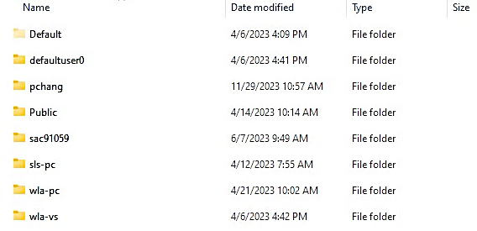
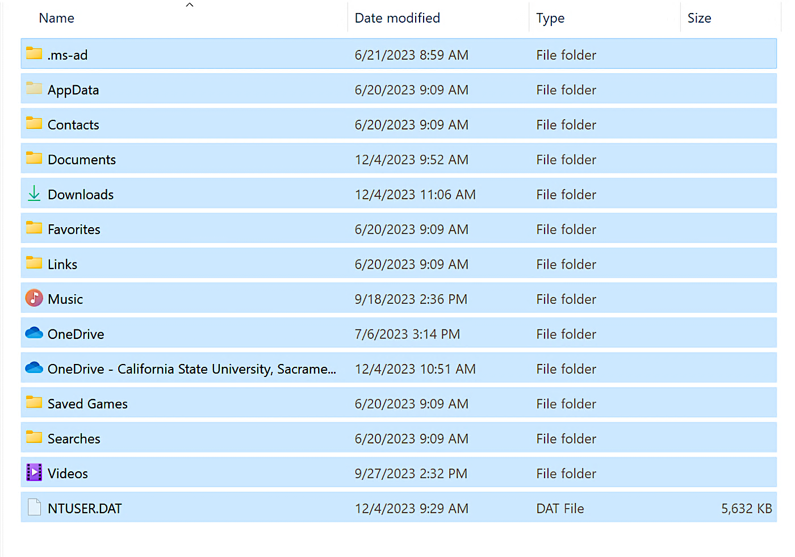
Backing Up All Your Files to OneDrive
Find your username from the folder list. It should have a combination of your initials and last name. (Example: pchang)
Click into that folder and copy everything. (This can be done by pressing CTRL+A at the same time)

Slide 8
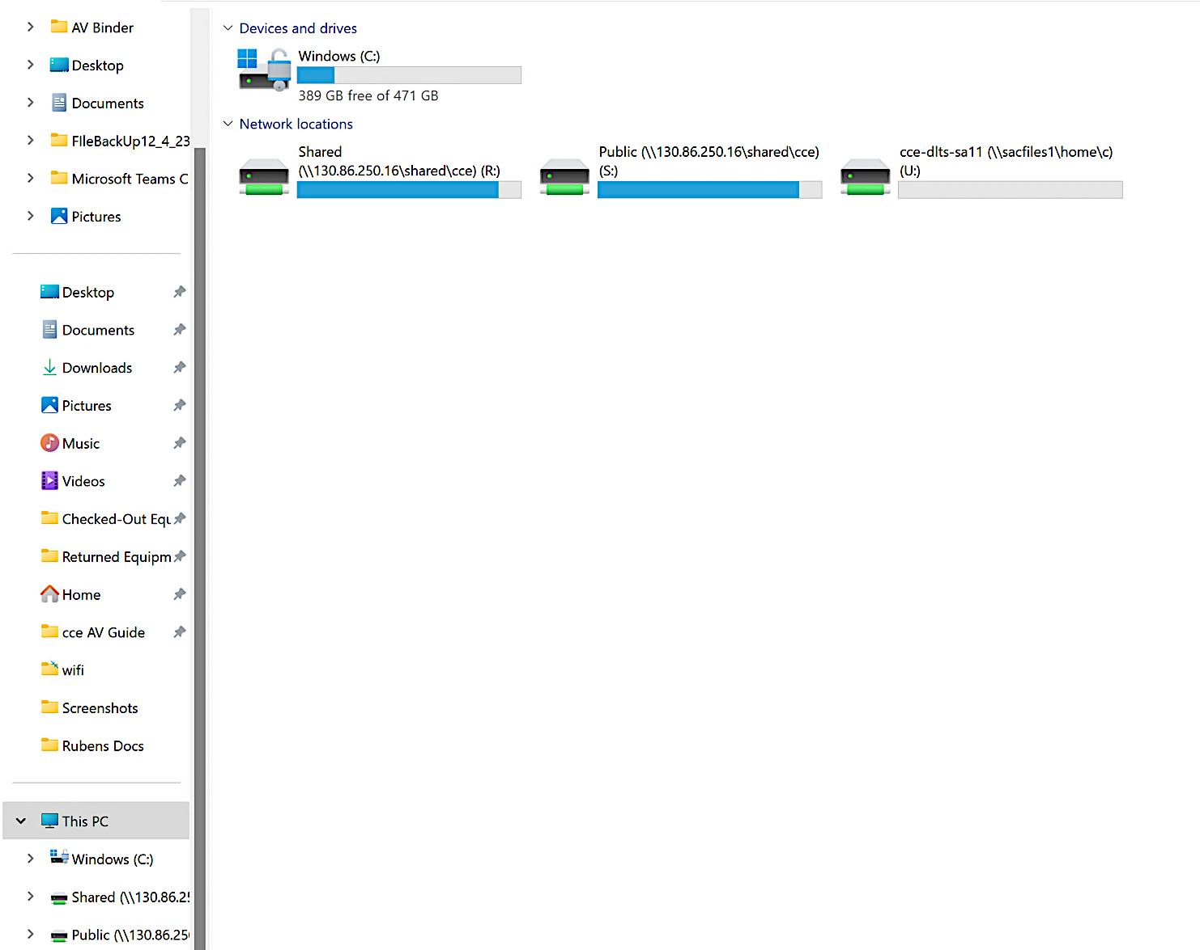
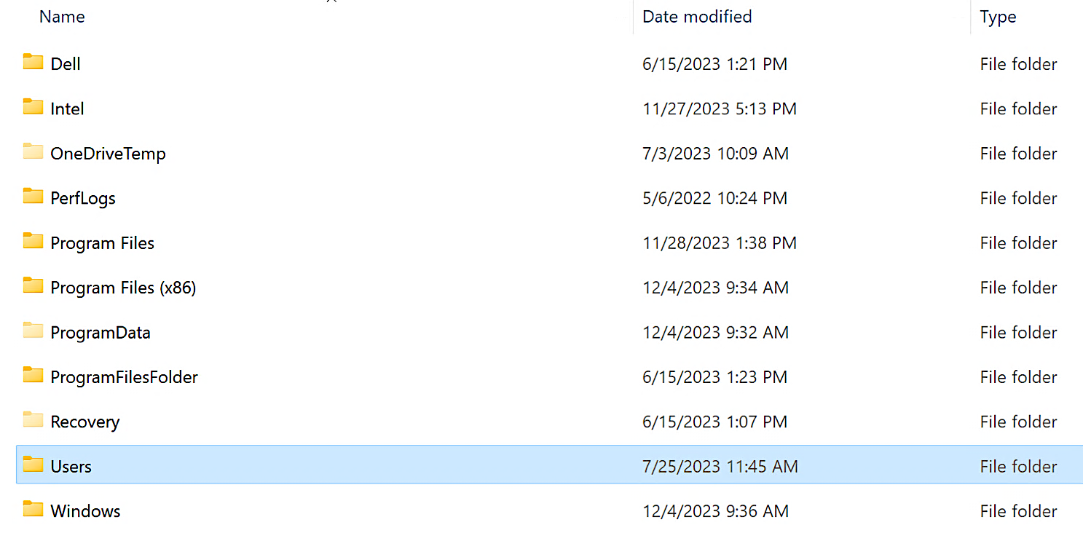
Backing Up All Your Files to OneDrive
Then click on the Windows (C:) drive.
Navigate to your File Explorer and click on This PC.
Click on the Users folder.

Slide 9
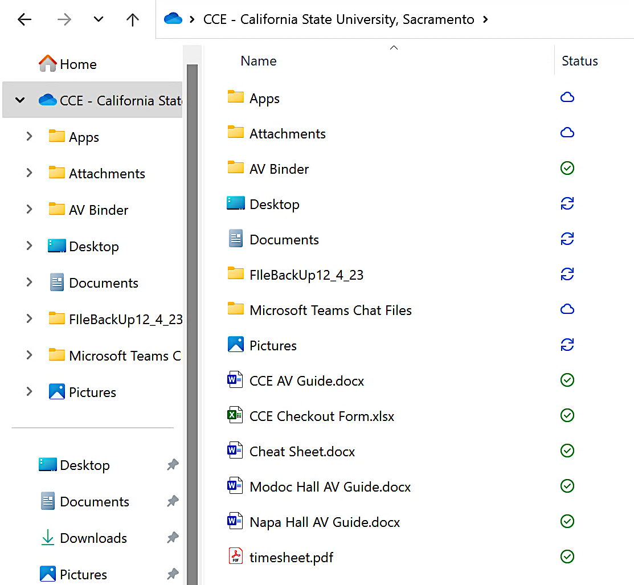
Backing Up All Your Files to OneDrive
Navigate back to your OneDrive and open the folder we created earlier named FileBackUp followed by today’s date.
Click into that folder and paste everything we copied earlier. (This can be done by pressing CTRL+V at the same time).
This will copy all the contents of your computer to the OneDrive for safe keeping. Disclaimer: The more files you have, the longer it will take.

Slide 10
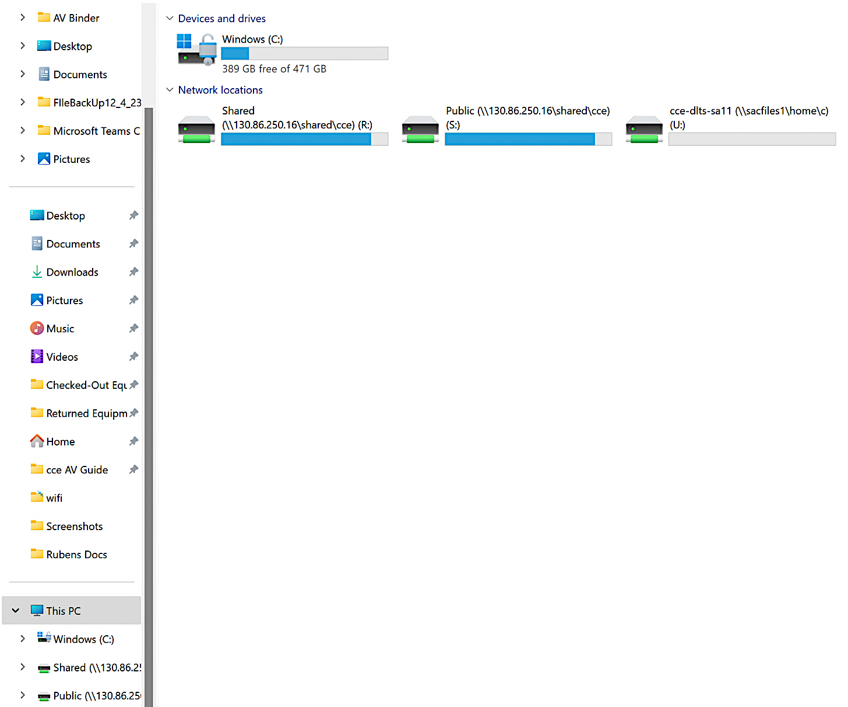
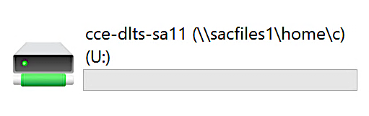
Saving Files to Your U: Drive
Navigate to This PC and click on the U: Drive.
Copy any file of your choice. (This can be done by selecting the file and pressing CTRL+C at the same time.)
Click into the U: Drive and paste the file of your choice. (This can be done by pressing CTRL+V at the same time.)
That file will be successfully saved to your U: Drive.

